Slide 1
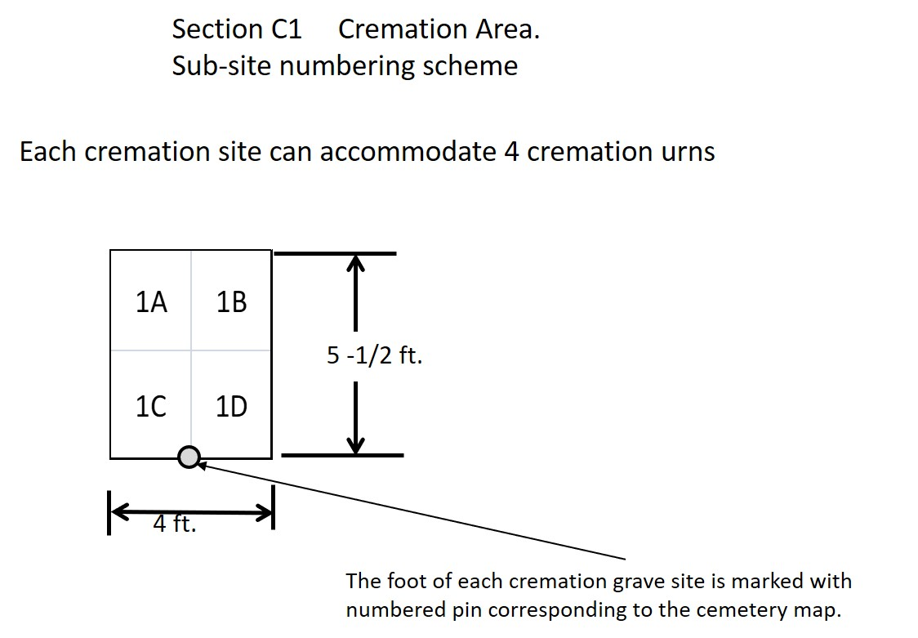
North Lebanon Cemetery, 85 Synagogue Road, Lebanon CT
May 13, 2020

Slide 2
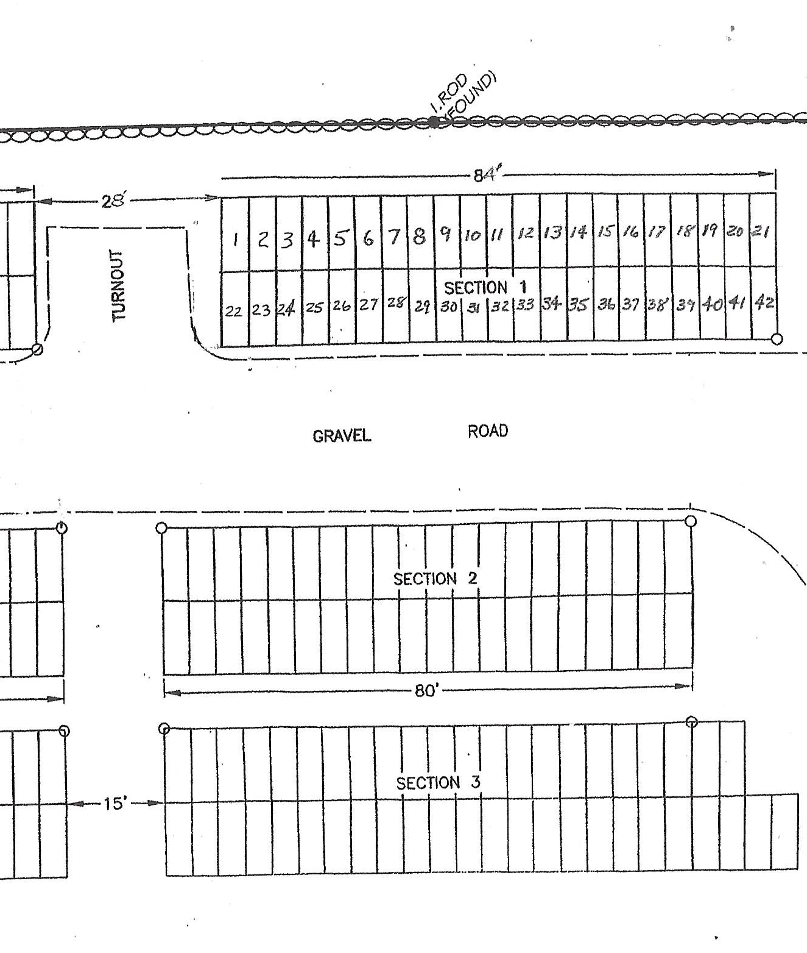
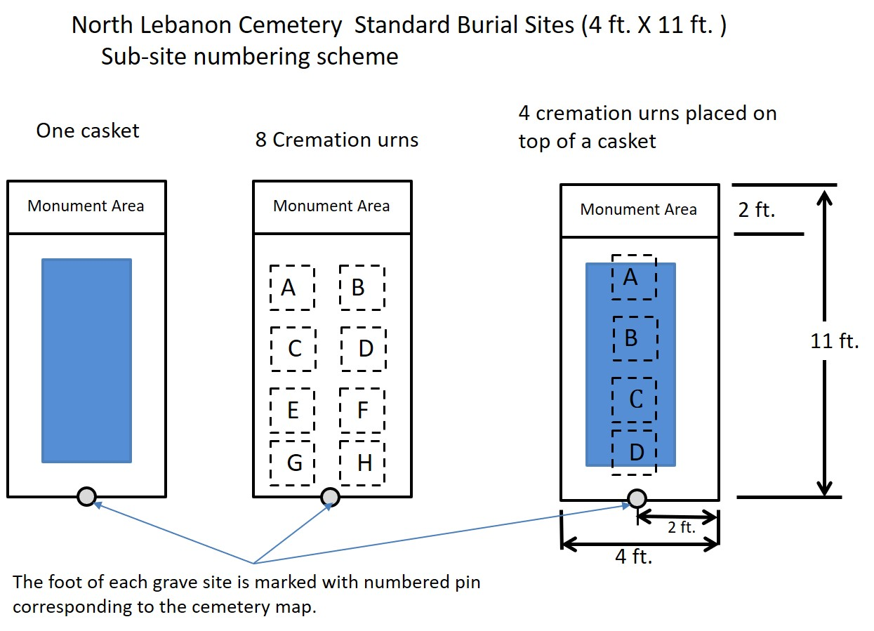
North Lebanon Cemetery, 85 Synagogue Road, Lebanon CT
May 13, 2020

